Slide 1
Optional Practical training
Kathy Kautz de Arango| March 1, 2024

Slide 2
Optional Practical Training
Definition and Eligibility
Allows an F-1 student to engage in employment after completing coursework to gain practical experience in his or her field of study and build a career.
OPT is the legal path to working in the U.S.
You DO NOT have to have a job to apply for OPT.
You are 100% responsible for your application. USCIS (not UIS) processes the application. They can approve or deny the application.
YOU ARE ELIGIBLE IF
You have attended at least 2 semesters at University of New Haven and are finishing your degree requirements in the current semester.
You have maintained full-time enrollment and there are no visa status violations in the past year.
You have not used OPT previously at the same education level.

Slide 3
Application Period
The earliest an OPT I-20 can be generated is 90 days before your program end date.
The latest date you can apply is 60 days past your program end date. NOTE: It can take more than 3 months for USCIS to adjudicate and send your EAD card, so it is always best to apply early.
You can request an EAD start date from June 1 to July 30. USCIS will usually honor this date if it is still in the future when they finish adjudicating. If the date has passed, USCIS will give you the date they approve the application.
You can apply even if you don’t yet have a job. But consult with UIS if you will be traveling.
March 4 to July 30, 2024

Slide 4
Application Guidelines
OPT information can be found in myCharger and an OPT Handbook is linked to the UIS webpages.
Complete the required Canvas course.
Prepare all your documents on the OPT Application Checklist and be ready to go. But DON’T submit the I-765 online before you have the OPT Request I-20.
Submit your OPT Request e-Form to the UIS. Upload scans of our passport, visa, I-94. If you want us to review a draft copy of the I-765 to be sure you got it right, you may upload a copy to this e-form.

Slide 5
Application Checklist
Prepare the Application Documents:
Form I-765 (Practice copy of I-765 fillable form at uscis.gov or print out a draft copy of the I-765 for the UIS. DO NOT submit the online application until you have all the evidence including the OPT Request I-20)
Copies of all previous I-20’s issued to you from the University of New Haven and any previous institutions. (USCIS is particularly interested in any I-20s with CPT or OPT authorizations on them.)
Color copy of your passport
Color copy of your visa
Copy of your I-94 record
Color copy of any previous EADs (if applicable)

Slide 6
Application Checklist (continued)
Submit to UIS
Post-completion Optional Practical Training Request E-Form along with the requested scans. All request forms are found in the new UIS portal.
Also Required in the OPT Application to USCIS
Two standard (2x2”) color passport photos (We recommend digital photos since they will need to be uploaded to the online form I-765.)
Make sure you have the money available to pay online. Payment must be by credit/debit card or ACH withdrawal from an American bank. (If filing the paper version, check or money order made payable to U.S. Department of Homeland Security)

Slide 7
How to Fill out the I-765
The UIS provides a guide to filling out the Form I-765.
Follow the guide on the Canvas course carefully
The I-765 fee is changing April 1 from $410 to $520. The premium processing fee will go from $1500 to $1685
USCIS is prone to changing paper versions of this form and then not accepting old versions. If filing the paper version, download the current form from www.uscis.gov/i-765

Slide 8
How to Fill out the I-765
Application for Employment Authorization
https://www.uscis.gov/i-765
Can be filed online from this site
Recommended to use the fillable paper form for practice.
Read the official USCIS I-765 instructions. What follows is a help, but should not be substituted for the official instructions.
The online form will look different, but I can help you understand the fields and what to submit in them.

Slide 9
Form I-765
REASON FOR APPLYING
When applying for OPT or STEM OPT work authorization, check the box “1.a. Initial Permission to accept employment.”
INFORMATION ABOUT YOU
Write your full legal name as it appears on your passport.
If you have had other legal names, you must complete the section on the right.
If your given name is too long to fit in the field, you may divide it into the first and middle name fields. (NOTE: The EAD card has limited characters, so long names may be chopped.)

Slide 10
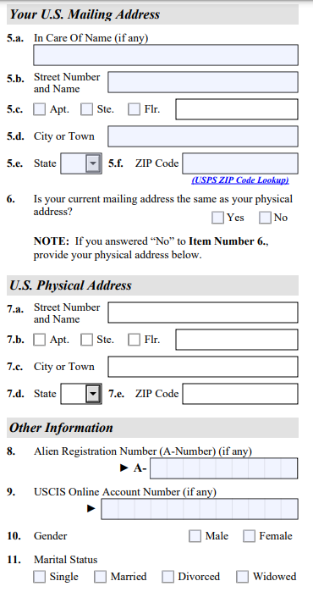
Form I-765
INFORMATION ABOUT YOU (continued)
Enter your U.S. Mailing Address for the application and EAD card
You should plan to live there 3-5 months into the future
If you prefer to use a friend’s address, write their name in question 5.a. Also use 5.a. if someone else’s name appears on your mailbox.
Answer if the mailing address is the same as your physical address.
If your physical address is different than your mailing address, fill in the physical address field.
You probably don’t have an A-number. If you filed for OPT at a previous degree level, you may already have a USCIS online account number(and should be using the same account for this application).
Answer your gender and marital status.

Slide 11
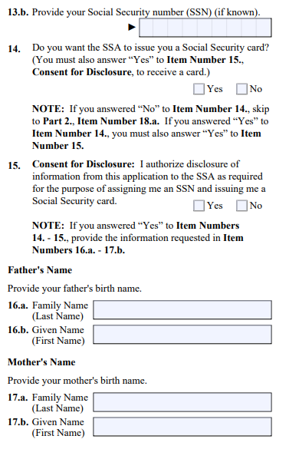
Form I-765
INFORMATION ABOUT YOU (continued)
Answer if you have previously filed an I-765 application. If you answer yes, you will be asked to upload a scan of your previous EAD card.
Answer yes or no if you have a Social Security Number (SSN). If you already have one, fill in the number.
If you don’t yet have an SSN, you will apply for one concurrently with the I-765 by using this form. Check, yes, you want SSA to issue the SSN to you.
The SSN application requires your parents’ names. This is just a formality.

Slide 12
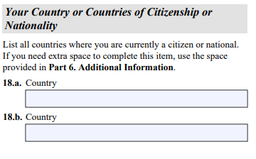
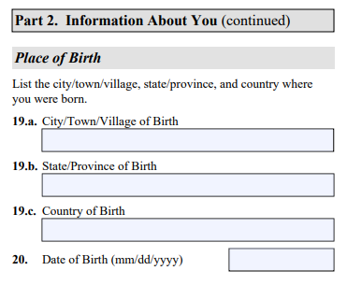
Form I-765
INFORMATION ABOUT YOU (continued)
List all countries of which you are a citizen.
List your place of birth, including city/town, state/province, and country of birth.
Provide your date of birth as per your passport.

Slide 13
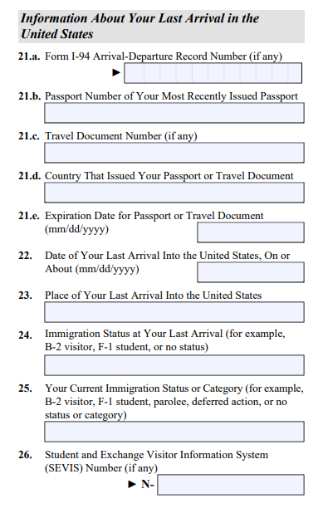
Form I-765
INFORMATION ABOUT YOUR LAST ARRIVAL
Provide information about your last arrival in the U.S. as per your most recent I-94. Date of arrival and the airport where you entered the U.S.
You may have entered under a different visa and changed status. Your current immigration status should be F-1 student.
You will have a passport (not a travel document). List country that issued your passport and the passport expiration date.
Enter the SEVIS ID from your current I-20

Slide 14
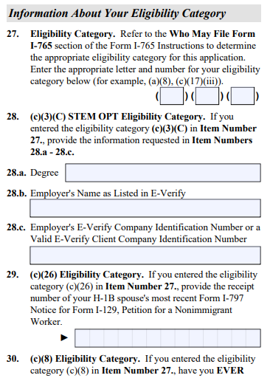
Form I-765
YOUR ELIGIBILITY CATEGORY
Post-Completion OPT after graduation: Enter code C-3-B You are NOT applying for Pre-Completion OPT (working prior to program end date). DO NOT ENTER code C-3-A
(Next year) The STEM Extension code is a new eligibility category C-3-C and will include a few more questions about your degree and your employer.
The paper application version asks a few questions that apply only to other categories. If you see strange questions online, you may have entered the wrong code.

Slide 15
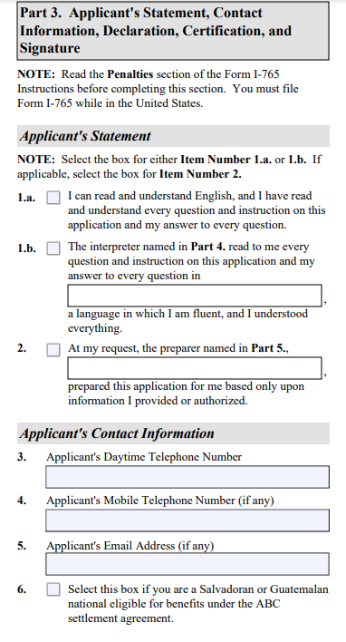
Form I-765
APPLICANT’S STATEMENT,CONTACT INFO, SIGNATURE
You have prepared and completed the application by yourself.
You can read and understand English.
Provide your cell phone number and personal email address. This facilitates communication.
You are not using a preparer (attorney). You are not using an interpreter so there is no one else’s information to disclose.
Sign and Date.

Slide 16
Form I-765
ADDITIONAL INFORMATION
You need the specific OPT Request I-20 to upload. You must not submit the I-765 without it, nor submit the I-765 more than 30 days from the date the OPT Request I-20 was issued.
You will upload identity documents: passport, visa, I-94
The online form will ask you to upload separately any I-20 that has CPT or OPT on it.
Regulations say you need to include all previous I-20s. Some upload all previous I-20s in the same slot. This is OK, but we recommend you upload only I-20s with CPT or OPT on them in the slot and upload all other previous I-20s after submission when the additional evidence slot opens.
You will also have to upload a copy of the EAD card if you previously did OPT (or include a copy in the paper packet).
The last thing is to submit payment. After you submit the payment, the form will lock and you will not be able to change any fields.

Slide 17
Filing the I-765 Application and Beyond
DO NOT submit the I-765 online without the OPT Request I-20 or your application may be denied.
If you submit the online I-765 more than 30 days from when the OPT Request I-20 was issued, your application will be denied. (Consider shipping time if filing the paper packet.)
You can track the progress of your application via your online account or on the USCIS website at https://egov.uscis.gov/ using your case number. (usually starts with IOE followed by 10 digits).
It is possible but difficult to withdraw an I-765 after it was submitted. Contact UIS if needed.
Please don’t email USCIS frequently. It will hurt not help you. It may take at least 90 days for USCIS to process your application.
You can pay extra to expedite your application. It is costly and may not be necessary if you apply early.
If you get a Request for Evidence (RFE), contact UIS for assistance. After you respond to the RFE, they will resume processing. Also contact UIS if your application is denied. You may be able to resubmit the application if it is not too late.

Slide 18
The Employment Authorization Document (EAD)
EAD card must be manufactured, so it will come in a separate mailing. The SSN card will also come in a separate mailing.
Make sure all information on the EAD card is correct as soon as you receive the card. (It is OK if a long name was chopped.)
If there are any errors, you must have them corrected by USCIS as soon as possible. The mailer with the EAD card will contain instructions.

Slide 19
You may not begin to work until …
You have the physical EAD card in your hands.
AND
The start date listed on your OPT card is reached. (eg. If you receive your card on June 1 and your EAD start date is July 1, you must wait until July 1 to begin work.)

Slide 20
Travel while on OPT
DO NOT TRAVEL outside of the U.S. while your application is processing
If you leave while your application is processing it can be considered “abandoning” your application.
Once you have received your EAD card, you can travel with these documents:
Your EAD card
Your I-20 with OPT approved and your employer listed on page two and a travel signature signed within the last 6 months
A valid passport and visa
Evidence of employment, like a job offer letter, employment verification letter, or paystubs
It may or may not be possible to renew a visa during OPT. If denied, you may not be able to re-enter the U.S. We recommend you inquire at the U.S. consulate nearest your home abroad before traveling.

Slide 21
Finding a Job
You are allowed 90 days of unemployment. This is the aggregate total out of your 1 year of post-completion OPT.
The 90 days start counting from the start date on your EAD card.
You must keep track of start and end dates for each employer.
SEVIS may or may not auto-terminate your OPT authorization if you exceed the 90 day limit. Even if SEVIS does not auto-terminate, you will likely get an RFE when applying for STEM and if you apply for an H1B in the future.
If you are approaching the 90 day limit, you can…
Volunteer for a non-profit organization using skills from your field of study (charitable non-profits that regularly use volunteers). You may not work without pay in a position that should be paid. This would be a violation of labor law and could be considered illegal.
Take an unpaid internship or research assistantship in your field of study (only if the internship is specifically designated as unpaid)
A list of possibilities is found on the UIS pages in myCharger.

Slide 22
Finding a Job (continued)
The job you take must be related to the degree you earned from the University of New Haven. (If you have a B.S. in Mechanical Engineering from Washington State University, but your UNH Master’s degree is Business, you cannot take a mechanical engineering job on Post-completion OPT.)
Additionally, if you took one Computer Science course while at UNH but did not major in Computer Science you cannot work in a Computer Science job.
The position should not be one that a non-educated worker might take, like a delivery driver for a warehouse.

Slide 23
Maintaining F-1 Status during OPT
You must work at least 20 hours per week on OPT. You can work multiple jobs to reach this total. If you work more than one job, you must provide a job offer letter and a brief description of how the job relates to your degree of study for each job.
When you receive your first job, please submit the Update OPT/STEM Employment Information form in the UIS Portal. Upload a copy of your EAD card and the job offer letter which states whether you are a full or part time employee, your start date, & the company address. Include a brief, 3-4 sentence explanation of how your job relates to your degree of study
UIS also needs all information even if you submit to your SEVP portal. Your SEVP portal is a window to the SEVIS Record. UIS has access to all fields in SEVIS and can update even if you are having issues with the portal.
Please note that your portal access is based on the email in your SEVIS record. UIS will update your email based on what you submit in any request form. Our data system will export to SEVIS your non-student email by default unless you request otherwise.

Slide 24
Maintaining F-1 Status during OPT (continued)
If you change jobs, you are responsible for providing UIS with this information for your new employer, as well as the final date at your previous employer.
During OPT, maintaining your status is all about reporting. UIS is here to serve you throughout your Post-completion and STEM periods of OPT. ALWAYS keep UIS informed of any changes to your employment as well as your address, phone and email.
Tell UIS within 10 days of changing a job, address or contact info. This is federal regulation.
Also keep UIS apprised of changes to marital status or immigration status (eg if you get an H1-B approval).
Submit your requests and inquiries via the UIS portal. UIS will answer in the order they are received within 3 to 5 business days. (3-5 Business days means 3-5 weekdays.)
You will continue to have access to the UIS portal AND information is available on the University external website even after you can no longer access myCharger. University Immigration Services Office - Information on OPT/STEM - University of New Haven

Slide 25
University immigration services
Campus Location:
One Stop Shop, Bergami Hall
Tel. 203-932-7475
uis@newhaven.edu
Please submit all inquiries and requests via the UIS portal
https://newhaven.edu/uisportal
Follow us on Instagram
unewhaven_uis
Open Q&A session for students who want to ask questions as they prepare the application on Wednesday August 6, 2024 at 12:30 pm
https://unewhaven.zoom.us/j/96434730152

